Slide 1

SPHOORTHY ENGINEERING COLLEGE
Nadergul,Rangareddy.
MAJOR PROJECT TITLE:
NUMBER PLATE DETECTION WITHOUT HELMET
GUIDE :
Mr. Miskeen Ali
TEAM MEMBERS:
A.Naga Akshita(18N81A05K7)
N.Nandini(18N81A05K5)
V.NavyaSree(18N81A05L1)
D.Amulya(18N81A05M4)

Slide 2
ABSTRACT:
Automatic number plate recognition (ANPR) is a method that uses character recognition on pictures to obtain vehicle registration plates with the use of existing CCTVs or traffic cameras, or task specific equipment. ANPR plays a significant role throughout this busy world, owing to the rise in vehicles day by day.
Among the fundamental process steps such as detection of number plate, segmentation of characters and recognition of each character, segmentation plays an important art, since the accuracy of recognition is based on how perfect the segmentation is done.

Slide 3
LITERATURE SURVEY
EXISTING SYSTEM
Existing system monitors the traffic violations primarily through CCTV recordings, where the traffic police have to look into the frame where the traffic violation is happening, zoom into the license plate in case rider is not wearing helmet. But this requires lot of manpower and time as the traffic violations and the number of people using motorcycles is increasing day-by-day.

Slide 4
PROPOSED SYSTEM
In the proposed system, first we apply adaptive background subtraction to detect the moving objects. After this, objects other than motorcyclists are discarded and passed only objects predicted as motorcyclist for next step where we determine wheather the motorcyclist is wearing a helmet or not. We assume that the head is located in the upper part of the incoming images and thus locate the head into top one fourth part of images. The located head of the motorcyclist is then given as input to CNN which is trained to classify with helmet vs. without-helmets.

Slide 5

SOFTWARE ENVIRONMENTS
TECHNOLOGIES USED
PYTHON
Python is an interpreted high-level general-purpose programming language. Its design philosophy emphasizes code readability with its use of significant indentation. Its language constructs as well as its object-oriented approach aim to help programmers write clear, logical code for small and large-scale projects.

Slide 6

OPEN CV(4.2.0.32)
OpenCV is a huge open-source library for computer vision, machine learning, and image processing. OpenCV supports a wide variety of programming languages like Python, C++, Java, etc. It can process images and videos to identify objects, faces, or even the handwriting of a human.
OpenCV is used for all sorts of image and video analysis, like facial recognition and detection, license plate reading, photo editing, advanced robotic vision, optical character recognition, and a whole lot more. We will be working through many Python examples here

Slide 7

YOLO
YOLO is an algorithm that uses neural networks to provide real-time object detection. This algorithm is popular because of its speed and accuracy. It has been used in various applications to detect traffic signals, people, parking meters, and animals.
Object detection is a computer vision technique for locating instances of objects in images or videos. Object detection algorithms typically leverage machine learning or deep learning to produce meaningful results. When humans look at images or video, we can recognize and locate objects of interest within a matter of moments. The goal of object detection is to replicate this intelligence using a computer.

Slide 8
CNN
A convolutional neural network (CNN or ConvNet), is a network architecture for deep learning which learns directly from data, eliminating the need for manual feature extraction.
CNNs are particularly useful for finding patterns in images to recognize objects, faces, and scenes. They can also be quite effective for classifying non-image data such as audio, time series, and signal data.
Applications that call for object recognition and computer vision — such as self-driving vehicles and face-recognition applications — rely heavily on CNNs.

Slide 9
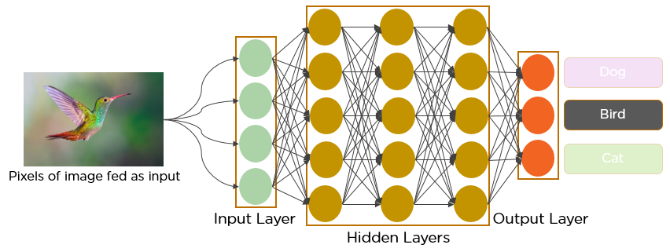

Slide 10
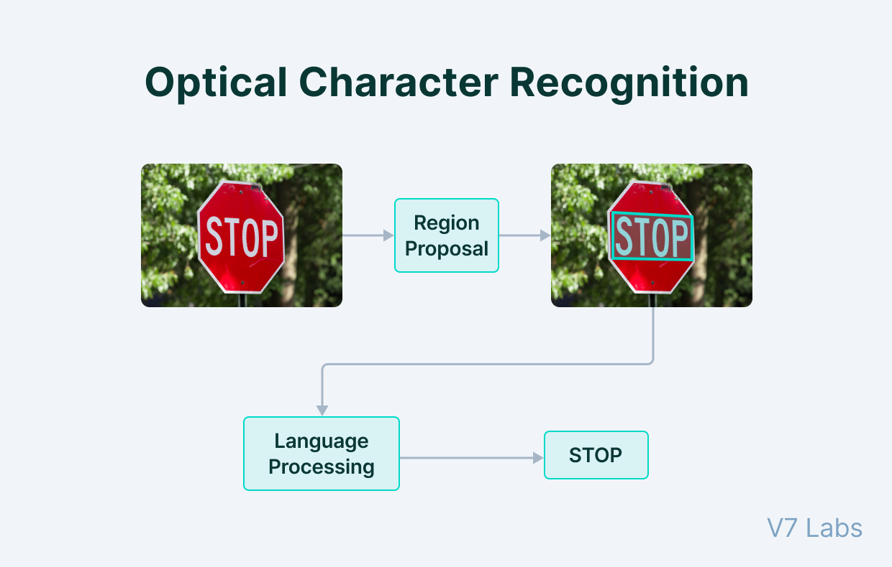
OCR
Optical Character Recognition (OCR) is the process of detecting and reading text in images through computer vision.
Detection of text from document images enables Natural Language Processing algorithms to decipher the text and make sense of what the document conveys.
Furthermore, the text can be easily translated into multiple languages, making it easily interpretable to anyone.
OCR, however, is not limited to the detection of text from document images only.

Slide 11
Tkinter
Tkinter is a Python binding to the Tk GUI toolkit. It is the standard Python interface to the Tk GUI toolkit and is Python's de facto standard GUI. Tkinter is included with standard GNU/Linux, Microsoft Windows and macOS installs of Python. The name Tkinter comes from Tk interface.
It is used to create Graphical User interfaces (GUIs) and is included in all standard Python Distributions. In fact, it's the only framework built into the Python standard library

Slide 12
BLOCK DIAGRAM
START
Input Frame
Read Next Frame
YES
Person
with Helmet?
NO
NO
Plate Detected
YES
END
Extract Plate

Slide 13
Start
Upload Image
Detect motor bike and person
Detect Helmet
End

Slide 14
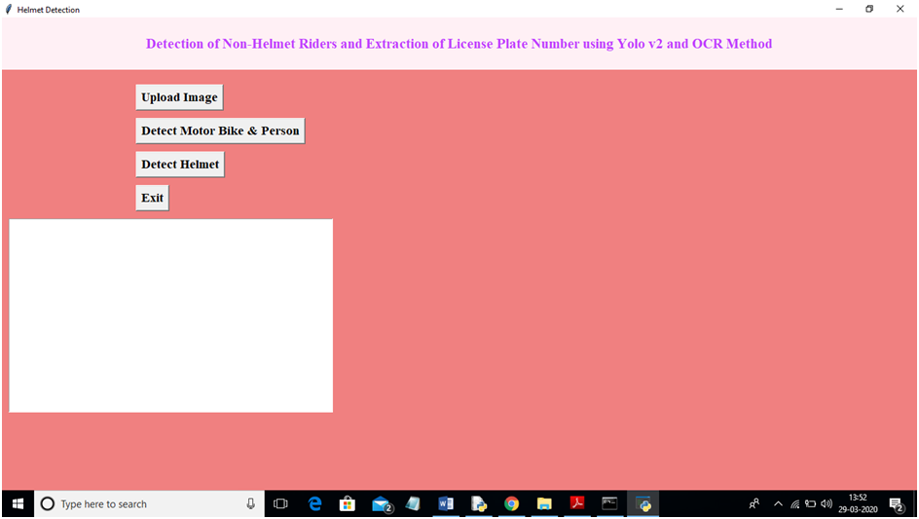
After setting path double click on ‘run’ file to run project and to get below screen

Slide 15
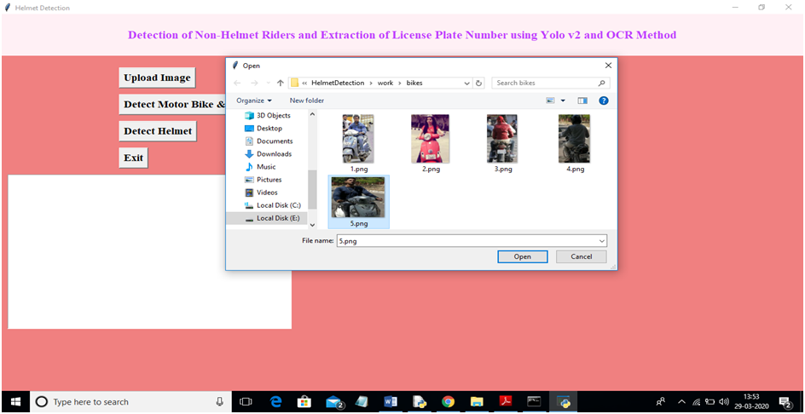
In above screen click on ‘Upload Image’ button and upload image

Slide 16
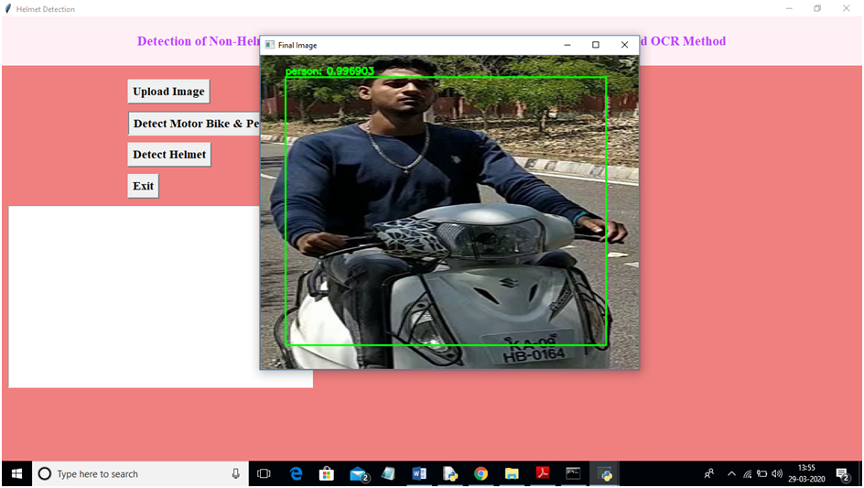
In above screen I selected one image and click on ‘Open’ button to load image. Now click on ‘Detect Motor Bike & Person’ button to detect whether image contains person with motor bike or not

Slide 17
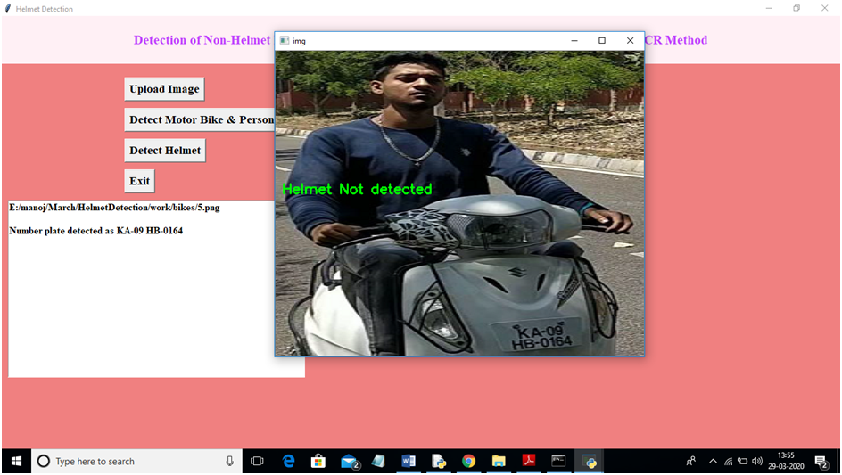
In above screen yolo detected image contains person and bike and now click on ‘Detect Helmet’ button to detect whether he is wearing helmet or not

Slide 18
FUTURE SCOPE
Automatic Vehicle Recognition System
Traffic Rules Violating

Slide 19
THANK YOU

